Slide 1



SNACK
ATTACK
Presented By
Tejeswi Devi Priya Pillarisetty
Sai Srilaxmi Linga
Aneetta Jijo
Sadhana Madepelli

Slide 2
PROJECT OVERVIEW
SnackAttack is a full-stack recipe web application where users can browse, save, and interact with recipes from all 50 U.S. states. It focuses on making food exploration more fun and personalized.
We created this project as a team of four developers using MongoDB, Express, React, and Node.js (MERN stack). Our app includes features like search filters, calorie calculator, ratings, favorites, and even admin control.

Slide 3
DATASET OVERVIEW
A dataset from Kaggle called AllRecipes - All US Recipes by State", which has over 4,000 recipes. It includes data like:
- Ingredients
- Directions
- Nutritional facts
- State origin
- Ratings
The dataset was ideal because it gave us enough real-world information to build multiple features. We cleaned and divided it into four main MongoDB collections:
- recipes: Main recipe content
- users: For handling registration & authentication
- favorites: Recipes users save to view later
- reviews: For storing user ratings and comments
This structure made it easy to manage the backend and connect features to the frontend.

Slide 4
FEATURES IMPLEMENTED
Main Features:
- User Authentication:* Secure login/register with JWT and password hashing
- Admin Management:* Admin can delete users and assign roles
- Ratings & Reviews:* Users can leave star ratings and comment
- Favorites System:* Logged-in users can save and access their favorite recipes
- Search & Filters:* Search by title, ingredient, and filter by category
- Trending Recipes:* Show popular recipes based on user activity
- Latest Recipes:* Sort and display newly added content
- Calorie Calculator:* Combine recipes and view total calories
- Download Recipes:* Export selected recipes as PDF or text

Slide 5
ROLES & RESPONSIBILITIES
We divided the tasks based on each person’s strengths and interests. Everyone focused on their own components and helped out during integration.
|Priya : Login/Signup, Nutrition Board | Authentication, Calorie Calculator, Download | Testing & Validation
Sai : Recipe Details, Favorites Page | User Ratings, Favorites | Database Schema Design
Aneetta : Admin Dashboard | User Management, Trending Recipes | GitHub Setup |
Sadhana : User Dashboard, Search | Latest Recipes, Search & Filtering | API Documentation

Slide 6
TEAM CONTRIBUTIONS & INDIVIDUAL WORK
Priya worked on authentication using JWT and bcrypt. She also created the calorie calculator that adds up nutrition info from selected recipes. She handled the download feature and led testing and debugging.
Sai designed the schema for MongoDB and created the reviews system. She also built the favorites feature where users can save and access recipes they like.
Aneetta took charge of the admin section. She developed a role-based system where admins can manage users and view trending recipes based on popularity logic.
Sadhana implemented the search and filter system. She also created the user dashboard to show the latest recipes and handled writing the API documentation.

Slide 7
CHALLANGES AND LEARNINGS
Challenges:
- Implementing JWT securely across all pages
- Keeping the favorites and ratings user-specific
- Designing filters that work fast even with large data
- Connecting all parts without breaking the app
What We Learned:
- How to work with MongoDB collections and structure data efficiently
- Importance of clean API design and consistent response formats
- Real-world authentication using tokens and password encryption
- Full-stack integration and teamwork in building a complete product

Slide 8
FUTURE SCOPES
We have a few cool ideas that we’d love to add in future versions of SnackAttack:
- User-Submitted Recipes: Let users contribute their own recipes
- Smart Suggestions: Recommend recipes based on user preferences
- Diet Filters: Add tags like vegan, gluten-free, high-protein, etc.
- Voice Search: Enable searching recipes with voice commands
- Shopping List Generator: Convert ingredients into a grocery list
- Social Sharing: Let users share their favorite recipes to Instagram or WhatsApp
These additions would make the app more engaging and helpful for food lovers.

Slide 9
LIVE DEMO
- A new user can register and log in securely using JWT-based authentication.
- Once logged in, they can search for recipes by name or ingredients.
- Recipes can be saved to a personal favorites list.
- Users can rate recipes and add their own comments.
- Admin users have access to a dashboard where they can manage other users.
- The nutritional board helps users calculate total calories from selected recipes.
- Recipes can also be downloaded for offline use.

Slide 10
SCREENSHOTS

Slide 11
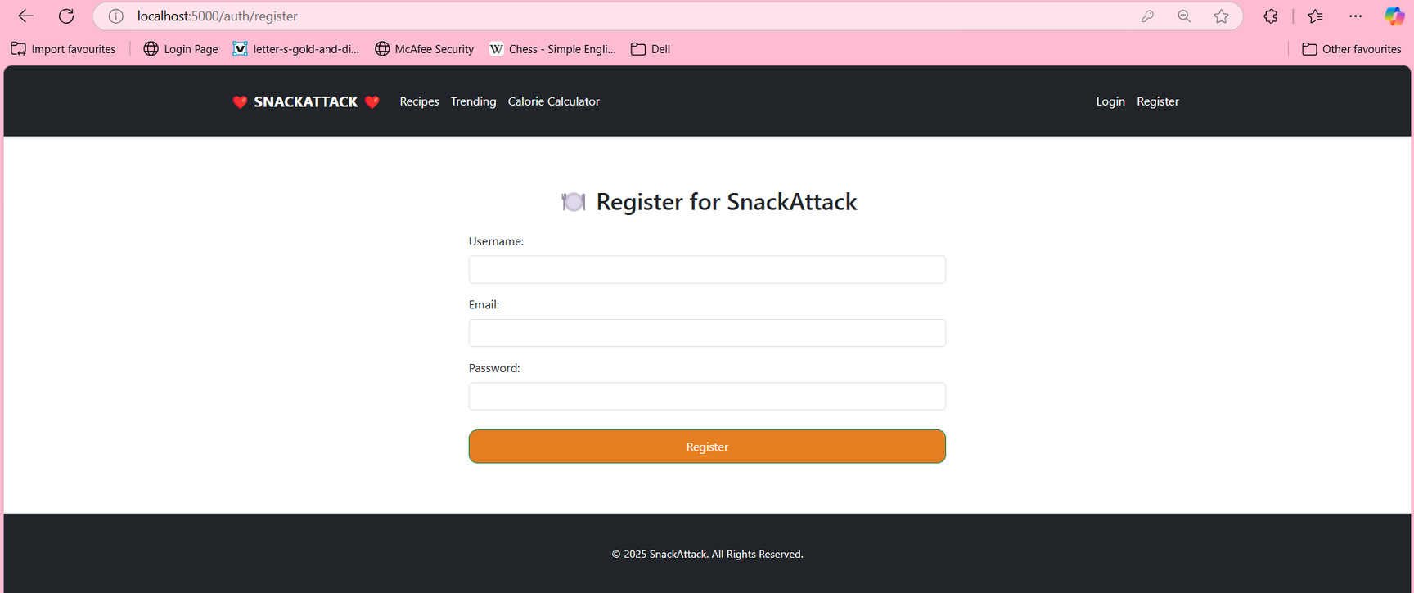

Slide 12
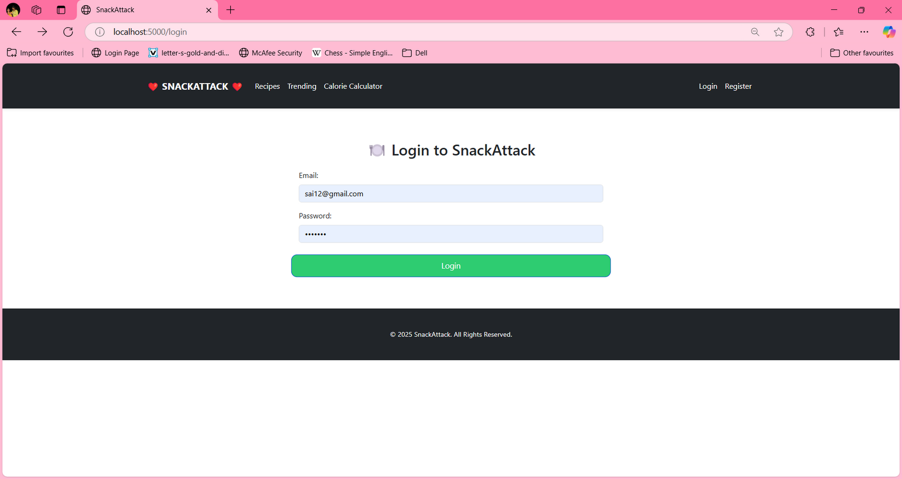

Slide 13
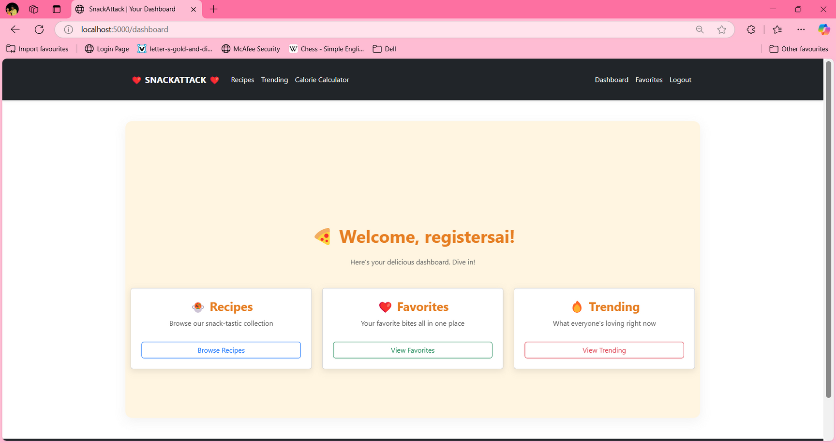

Slide 14
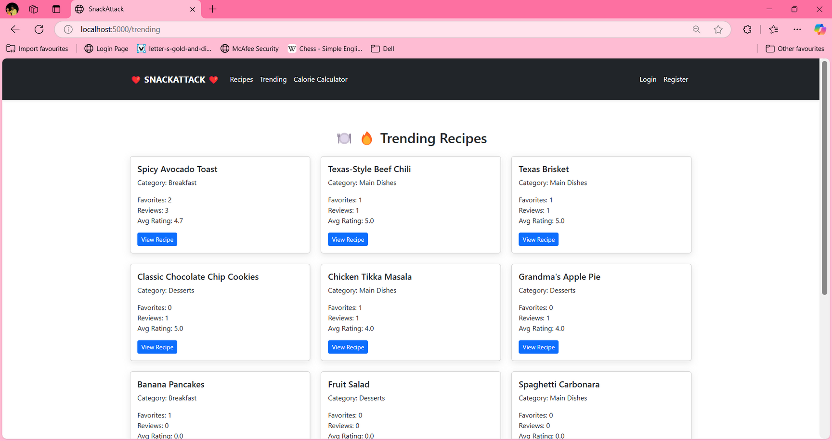

Slide 15
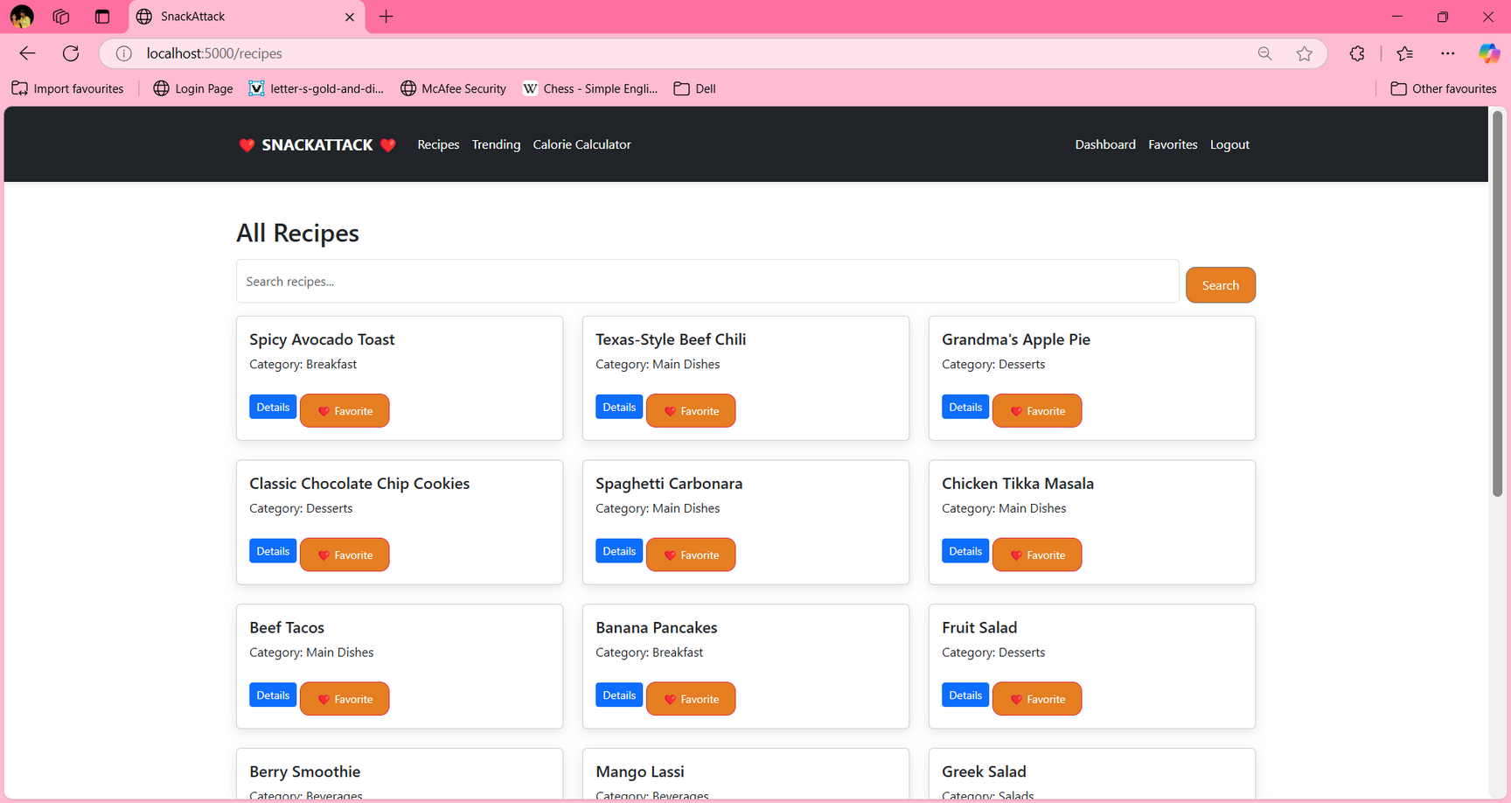

Slide 16
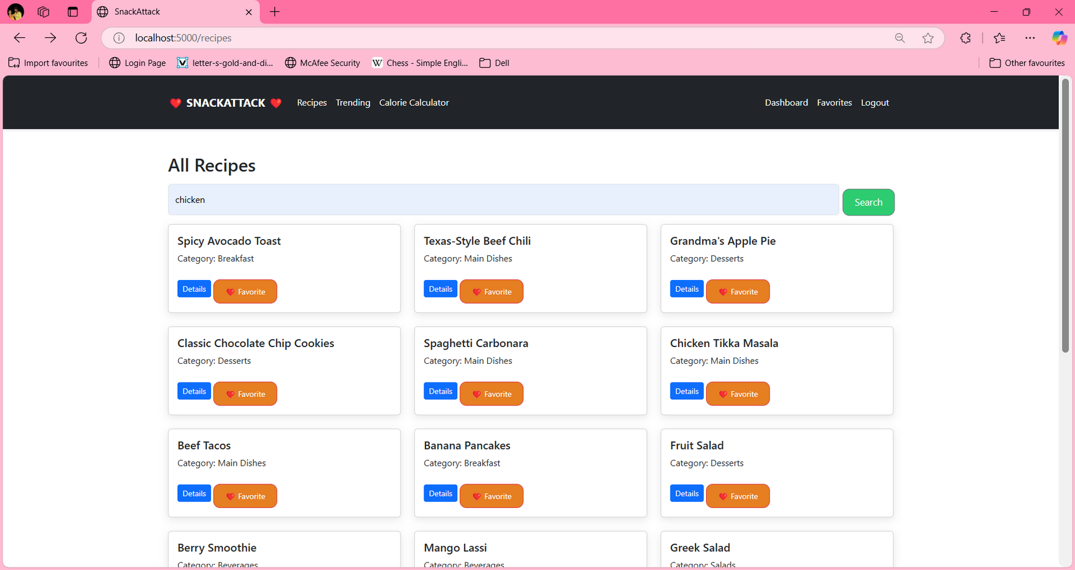

Slide 17
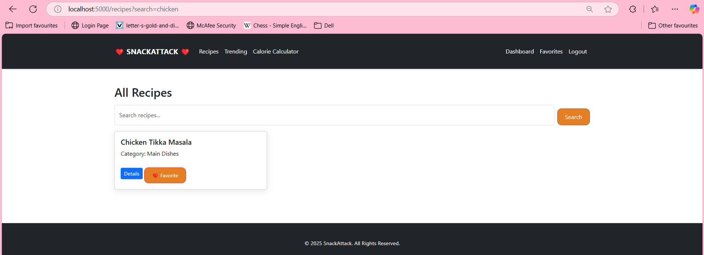

Slide 18
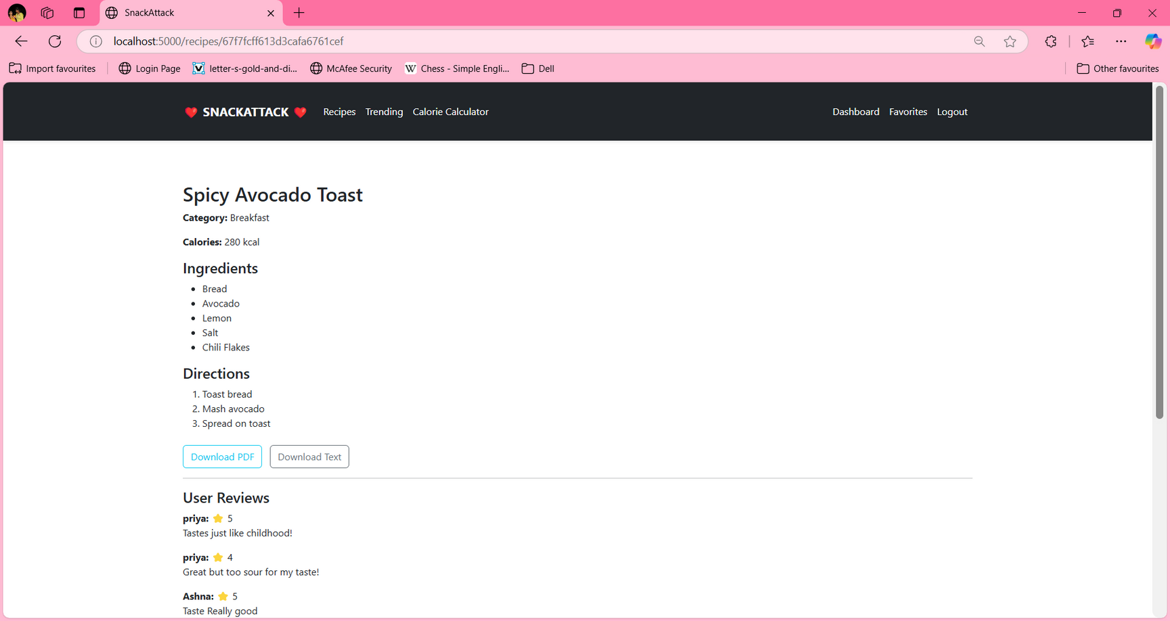

Slide 19
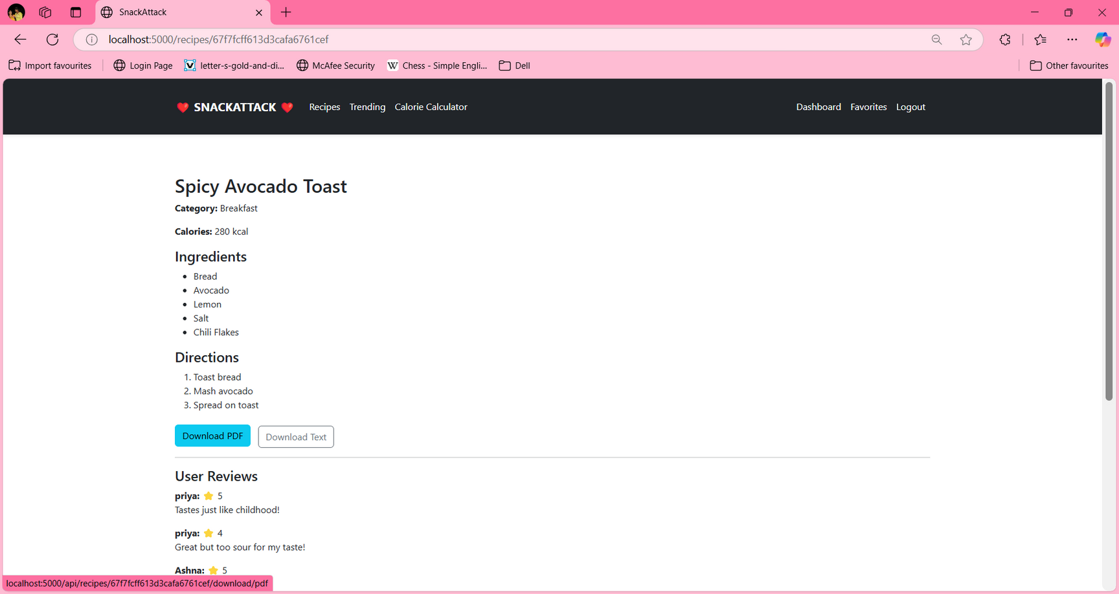

Slide 20
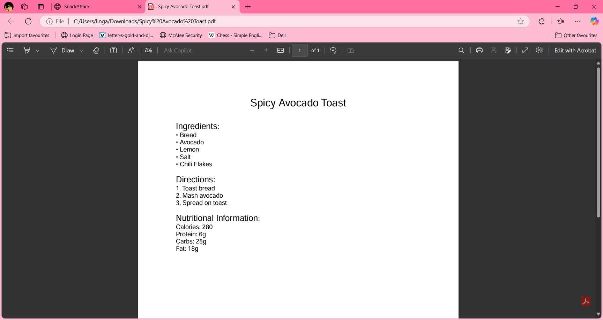

Slide 21
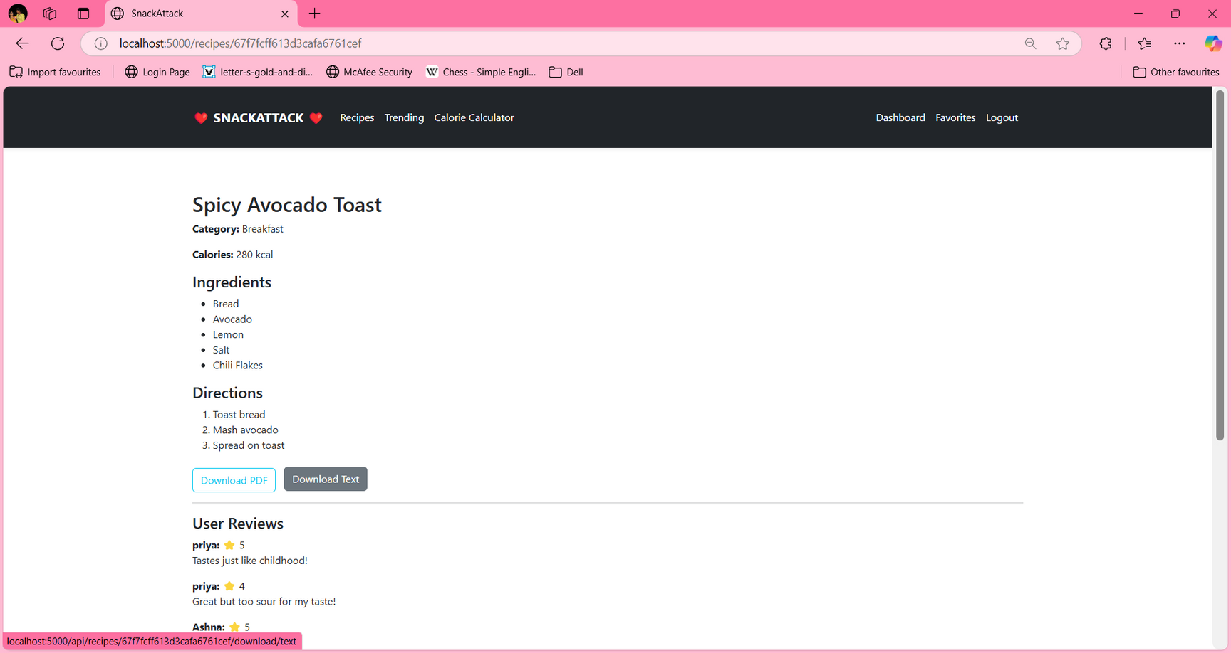

Slide 22
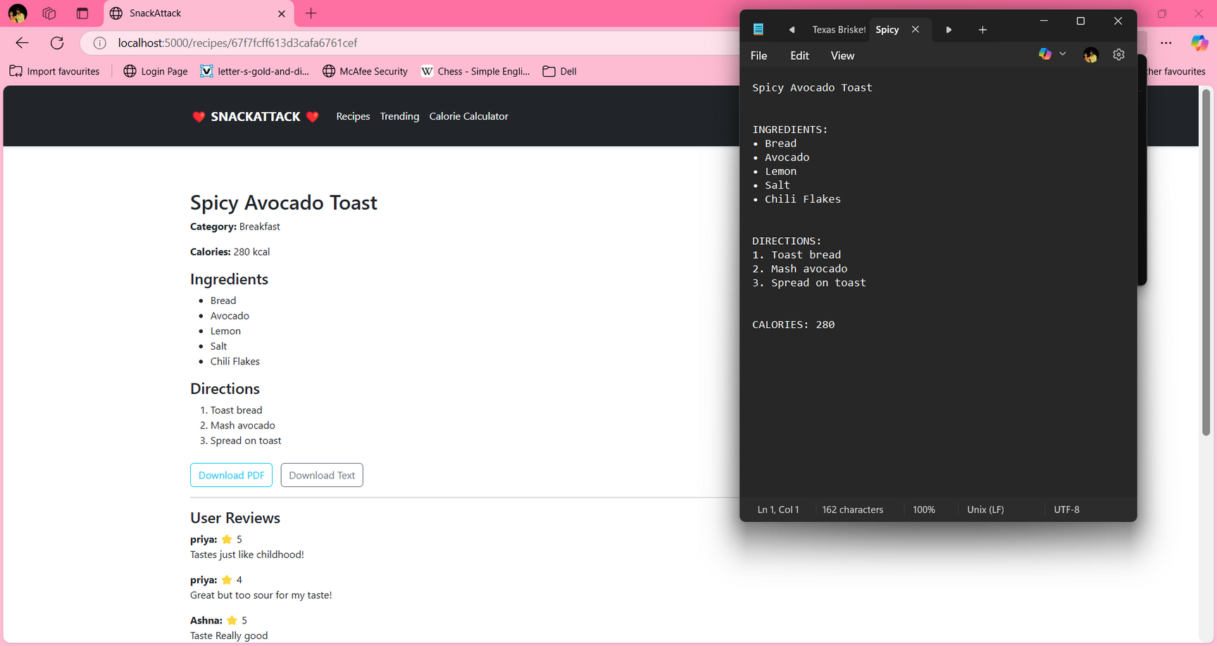

Slide 23
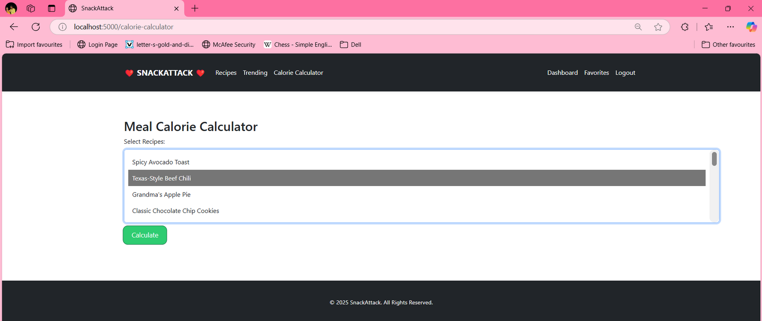

Slide 24
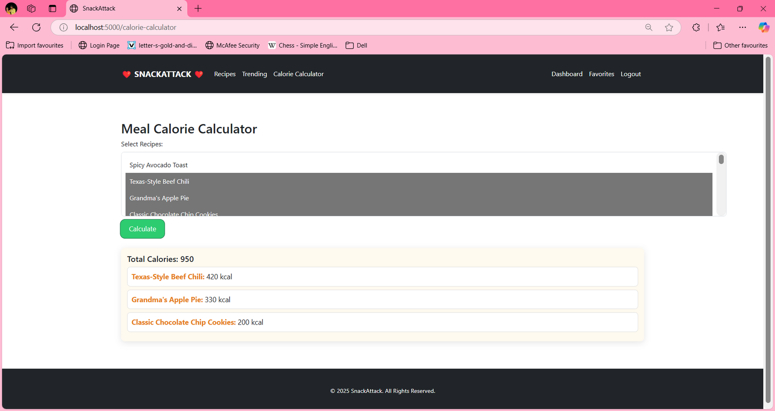

Slide 25

THANK YOU

